Slide 1
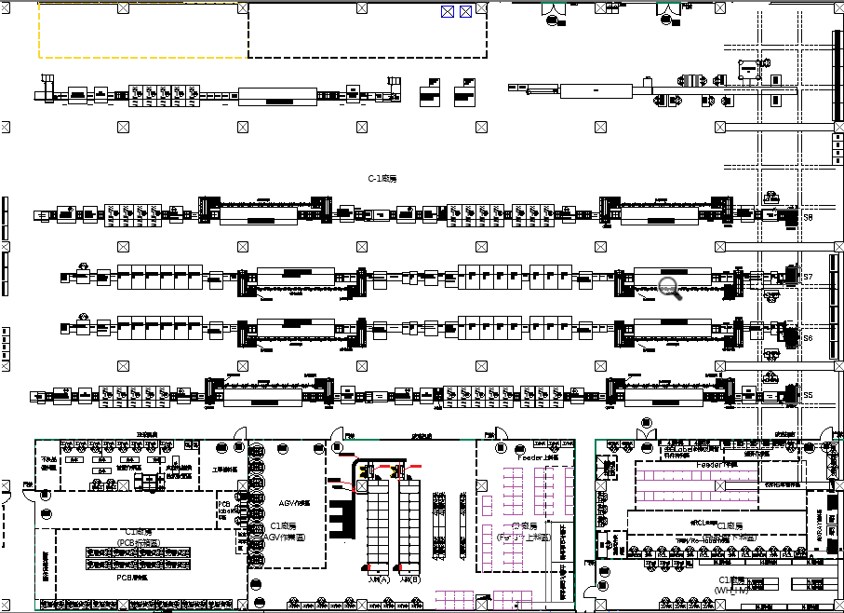

2F AMR 動線(6)
去程
回程
下料點
S10
出發點
S8
S7
S6
S5
進
出

Slide 2
"position": {
"y": 111.37762451171875,
"x": 63.451873779296875,
"orientation": -2.4152464866638184
S10
"position": {
"y": 113.03822326660156,
"x": 63.526031494140625,
"orientation": -1.5363106727600098
S8
S7
S6
"position": {
"y": 114.91315460205078,
"x": 63.42900466918945,
"orientation": -1.3887649774551392
S5
進
出
"position": {
"y": 116.28658294677734,
"x": 63.47187042236328,
"orientation": 0.3250671625137329
"position": {
"y": 117.76449584960938,
"x": 63.46272277832031,
"orientation": -2.093160390853882

Slide 3
S10
S8
S7
S6
"position": {
"y": 110.9206771850586,
"x": 50.239356994628906,
"orientation": -177.23516845703125
S5
進
出
"position": {
"y": 118.75105285644531,
"x": 45.74491882324219,
"orientation": 88.27165985107422
"position": {
"y": 120.6728744506836,
"x": 36.71027374267578,
"orientation": -92.72713470458984

Slide 4
S10
S8
S7
S6
"position": {
"y": 108.35665893554688,
"x": 41.9348258972168,
"orientation": -0.3081665337085724
}
S5
進
出

Slide 5
S10
S8
S7
S6
"position": {
"y": 109.16900634765625,
"x": 78.43724822998047,
"orientation": 8.34423828125
S5
進
出

Slide 6
S10
S8
S7
S6
"position": {
"y": 96.61384582519531,
"x": 86.50155639648438,
"orientation": -140.26400756835938
S5
進
出

Slide 7
S10
S8
S7
S6
"position": {
"y": 96.45218658447266,
"x": 48.560752868652344,
"orientation": 179.93112182617188
}
S5
進
出

Slide 8
S10
S8
S7
S6
S5
進
出

Slide 9
S10
S8
S7
S6
"position": {
"y": 96.55615234375,
"x": 13.471678733825684,
"orientation": 179.35476684570312
}
S5
進
出

Slide 10
S10
S8
S7
S6
"position": {
"y": 99.98018646240234,
"x": 6.445448398590088,
"orientation": 85.13031768798828
S5
進
出

Slide 11
S10
S8
S7
S6
"position": {
"y": 109.16175079345703,
"x": 10.85538387298584,
"orientation": -8.841797828674316
}
S5
進
出

